Slide 1
DEEP LEARNING • NLP
Neural Machine Translation
Arabic ↔ English
Build a Seq2Seq LSTM neural machine translation system with Bahdanau attention.
GOAL
DATA
MODEL
Arabic → English neural translation
100K+ parallel sentence pairs
LSTM Encoder–Decoder + Attention
EVALUATION
OUTPUT
TOOLS
BLEU on held-out data
Translation + attention visualization
• PyTorch • NLTK • sacrebleu
• Streamlit
CORE IDEA
Arabic
Encoder
Attention
Decoder
English
01

Slide 2
SECTION 02 • TECHNIQUES
IMPLEMENTATION
Project workflow & Seq2Seq architecture
The complete path from raw parallel data to an evaluated translation.
MODEL FLOW
Arabic
sentence
Tokenization
+ IDs
Embedding
LSTM
Encoder
Bahdanau
Attention
LSTM
Decoder
English
output
Encoder = reads + stores context
Attention = selects useful source states
Decoder = generates one token at a time
02

Slide 3
SECTION 02 • TECHNIQUES
ENCODER
1. Encoder: understand the source sentence
The encoder reads Arabic tokens sequentially and produces contextual hidden states.
أنا
أحب
التعلم
What the encoder gives us
• Each token becomes a dense embedding vector.
• The LSTM updates its hidden state as it reads.
• We keep the sequence of hidden states.
• Attention can later inspect these states.
LSTM
LSTM
LSTM
h₁
h₂
h₃
Key idea: the encoder reads; it does not produce the English sentence.
03

Slide 4
SECTION 02 • TECHNIQUES
DECODER
2. Decoder: generate the target sentence
The decoder predicts one English token at a time until <EOS>.
<SOS>
I
love
learning
<EOS>
Example at one decoding step
love
72%
previous token + previous state + attention context → next-token probabilities
like
14%
LSTM Decoder
enjoy
8%
other
6%
Teacher forcing (training)
During training, the decoder can receive the ground-truth previous token instead of its own previous prediction.
04

Slide 5
SECTION 02 • TECHNIQUES
ATTENTION
3. Bahdanau Attention: focus on the right source words
Attention prevents the decoder from relying on one fixed sentence representation.
أنا
أحب
التعلم
Decoder step
8%
17%
75%
Context
vector
Predict next
English token
using the
context vector
Example: when predicting “learning”, attention can assign the highest weight to التعلم.
05

Slide 6
IMPLEMENTATION • WRAP-UP
SUMMARY
End-to-end implementation map
The whole project can be remembered as: Read → Align → Generate → Evaluate.
DATASET
Arabic ↔ English pairs
Final demo
PREPROCESS
clean → tokenize → PAD / <SOS> / <EOS>
Input
Arabic sentence
Model
Encoder + attention + decoder
ENCODER
Embedding → LSTM hidden states
Output
Generated English sentence
ATTENTION
alignment scores → context vector
Evidence
BLEU on held-out data
Interpretability
Attention weights per source word
DECODER
LSTM → Dense / Softmax → next token
METRICS
BLEU + qualitative examples
Read → Align → Generate → Evaluate
06

Slide 7
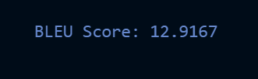
PROJECT RESULTS • DATASET 01
ERROR ANALYSIS
Opus / Helsinki NLP — First Baseline
The first experiment exposed a problem: the model was not yet meeting the target BLEU score.
BLEU SCORE
Bad implementation? Missing step? a Bug?
12.92
• A low BLEU score alone does not tell us what is failing.
• We inspect the data and the model's actual predictions.
• Outliers, very long sentences, and poor alignments can distort performance.
• Low Quality data can cause training to be poor
Target: 20
BLEU Score < Target
Baseline result
Why is the score low?
Error analysis helps us decide
07

Slide 8
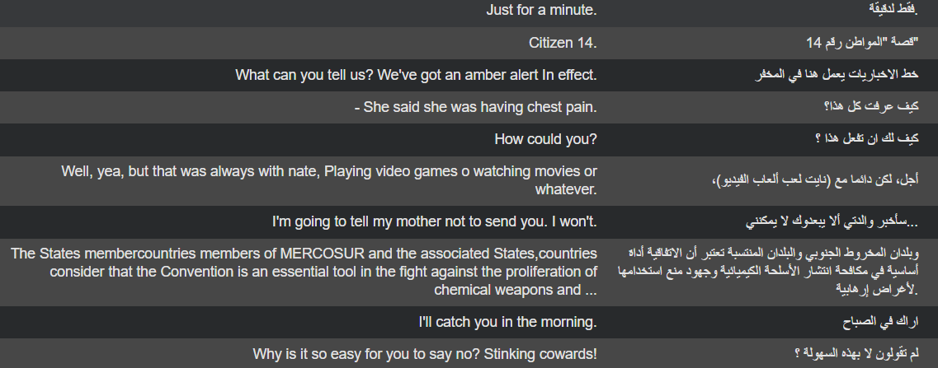
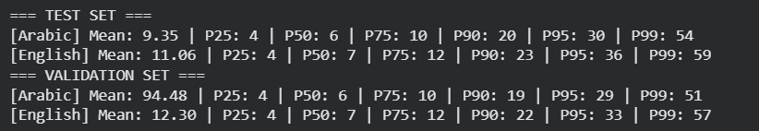
Error Analysis — What did I find?
ERROR ANALYSIS
Data Set inspection
By only showing a random sample of the data but it showed that many samples have corrupted translations which will surely lead to a bad training
Length distribution snapshot
The validation and test sets both showed also corruption..
For example: How can 99% of data be less than 51 words and the average is 94 words.
One of the samples of the validation set was 171K words !!!!! (LOW QUALITY DATA SET !!)
08

Slide 9

PROJECT RESULTS • DATASET 02
DATASET CHANGE
Tatoeba — high quality 30K Pairs
After the error analysis, the dataset was changed to a cleaner and a higher quality data set.
DATASET 02
Tatoeba Draw Back
Tatoeba
Better BLEU — but a narrow domain
30K sentence pairs
• Tatoeba consists of very short sentences.
• The model therefore becomes specialized in translating short sentences.
• This motivated testing a dataset with short, medium, and long sentences.
Result
26.55 BLEU
Milestone achieved: > 20
Beam Search > Greedy
09

Slide 10

PROJECT RESULTS • DATASET 03
DATASET CHANGE
Wikipedia — 86K Pairs
A larger corpus was used to test whether the model could handle short, medium, and long sentences.
DATASET 03
Second milestone achieved
Wikipedia
25.63 BLEU > 20
86K sentence pairs
• The dataset is substantially larger than Tatoeba.
• It covers short, medium, and long sentences.
• The BLEU score remains above the project target.
• This gives a more meaningful test of general sentence-length handling.
Sentence range
1 → 35 words
Result
10

Slide 11
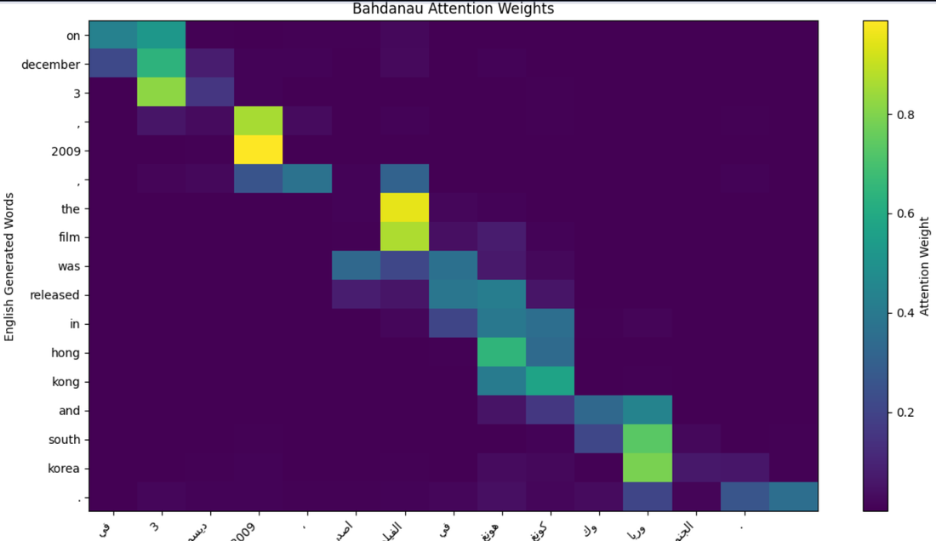
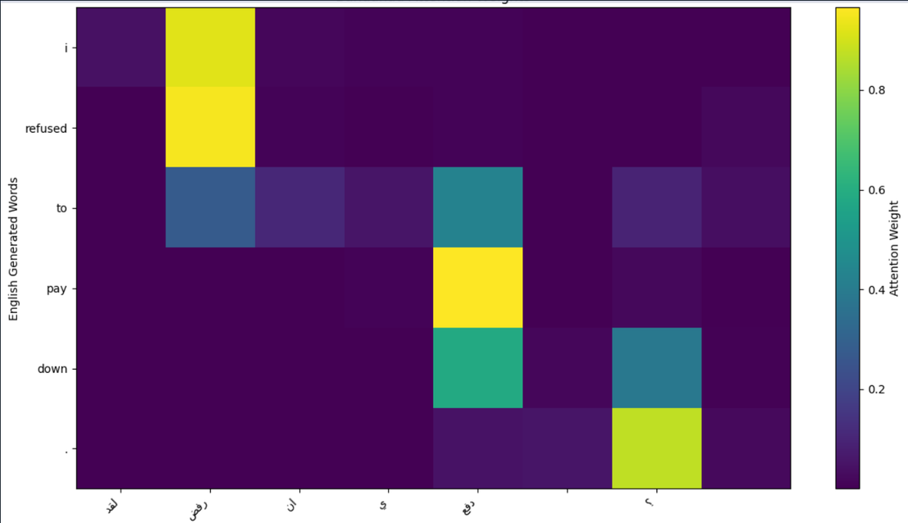
PROJECT RESULTS • INTERPRETABILITY
ATTENTION
Attention Visualization — Does the model align words?
Bahdanau attention weights show which Arabic source tokens receive focus while generating each English token.
Example 01
Example 02
BRIGHTER CELLS = HIGHER ATTENTION WEIGHT
11

Slide 12
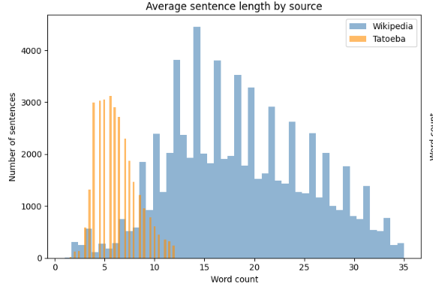
PROJECT RESULTS • DATASET COMPARISON
DATA ANALYSIS
Tatoeba vs Wikipedia — Sentence Length
The two datasets differ substantially in sentence-length distribution.
Average sentence length by source
TATOEBA
Mostly short
sentences
WIKIPEDIA
Broad range of all sentences types
WHY THE DATASET CHOICE MATTERS
A higher BLEU score must be interpreted together with the data distribution.
12

Slide 13

PROJECT RESULTS • DATASET FUSION
FINAL ENGLISH MODEL
Why not both? — Tatoeba + Wikipedia
Combining the complementary datasets produced the strongest English-generation result so far.
TATOEBA
WIKIPEDIA
COMBINED MODEL
+
30K pairs
86K pairs
27.48 BLEU
Short-sentence strength
Broader sentence lengths
Beam search • width = 5
Evaluation result
Why better results
• Short-sentence coverage from Tatoeba.
• Broader length coverage from Wikipedia.
• Combined model improves English BLEU to 27.48.
BEST ENGLISH BLEU SO FAR
13

Slide 14
PROJECT EXTENSION
WHAT IF WE GO ONE STEP FURTHER?
The original project focuses on Arabic → English.
I extended it to support the reverse direction too.
↔
BIDIRECTIONAL TRANSLATOR
ARABIC
ENGLISH
14

Slide 15
PROJECT EXTENSION • EXTRA MILE
BI-DIRECTIONAL TRANSLATION
Beyond the original Arabic → English scope
I extended the system to translate in BOTH directions.
A project extension
→
↔
→
ARABIC
ENGLISH
ENGLISH
ARABIC
Original direction
NEW CAPABILITY
21.16 BLEU
English → Arabic
TARGET > 20
WHY IT MATTERS
✓ MILESTONE
The model is now a full Arabic ↔ English translator.
15

Slide 16
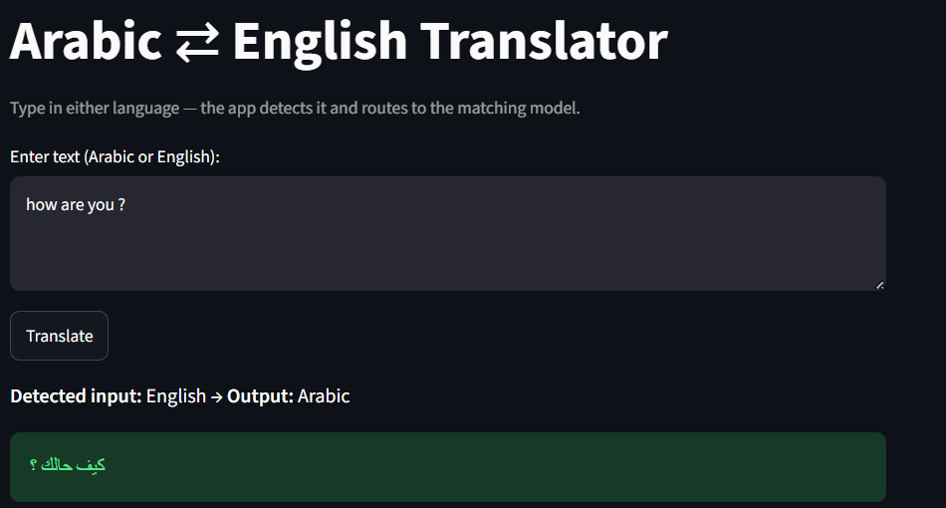
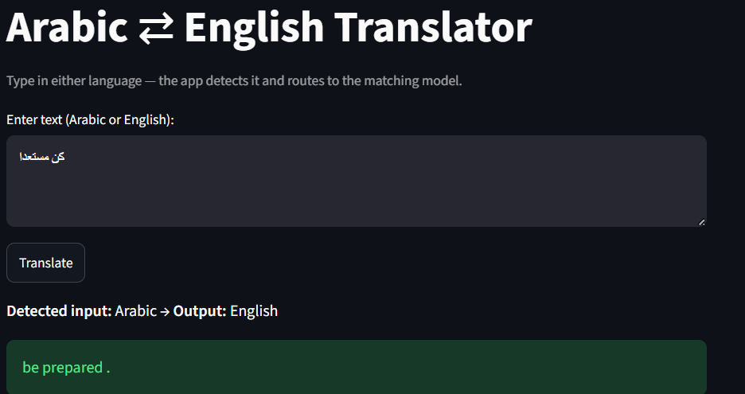
PROJECT DEMO • DEPLOYMENT
FINAL DEMO
Live Deployment — Automatic Language Detection
A simple interface accepts either language, detects the input direction, and routes it to the matching model.
English → Arabic
Arabic → English
Input → Detect language → Route to model → Translate
16

Slide 17
EXTRAS
Going Beyond the Core Project
Additional experiments: Transformer architecture, paragraph-aligned translation, and transfer learning.
TRANSFORMER
PARAGRAPH-LEVEL MT
TRANSFER LEARNING
17

Slide 18
EXTRAS • EXPERIMENT 01
TRANSFORMER
Transformer on Tatoeba Data Set
The same Tatoeba dataset was tested with a Transformer architecture and beam-search decoding.
TEST BLEU
What changed?
35.19
• Replaced the recurrent Seq2Seq architecture with a Transformer.
• Evaluated both greedy decoding and beam search.
• Beam search improved the test BLEU from 33.62 to 35.19.
• This experiment shows the benefit of a stronger sequence model and decoding strategy.
Beam search
33.62
Greedy decoding
35.19 — HIGHEST TATOEBA RESULT
18

Slide 19
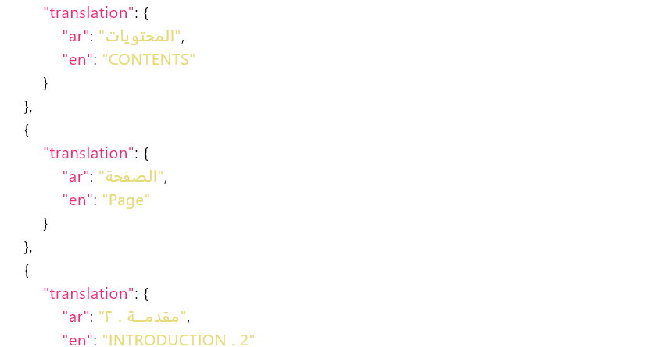
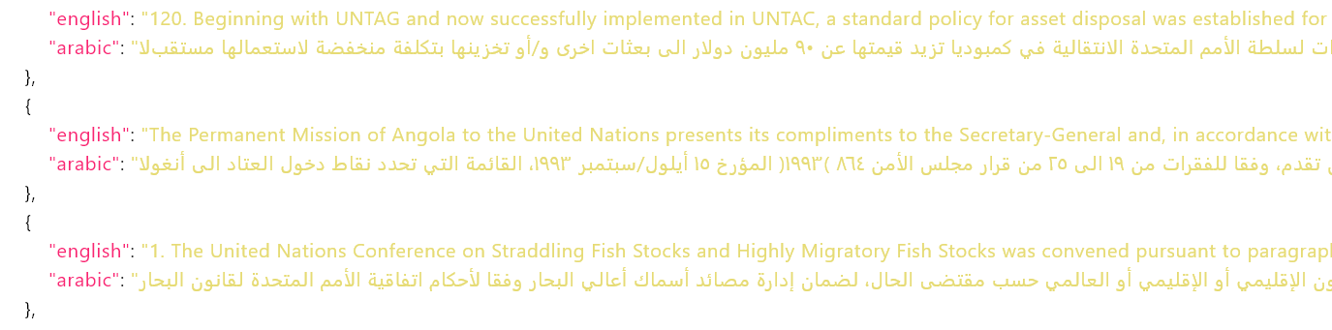
EXTRAS • EXPERIMENT 02
PARAGRAPH MT
Paragraph-Aligned EN ↔ AR Translation
The goal was to move beyond isolated sentences and construct high-quality aligned paragraphs.
DATASET PREPARATION
Before processing
UN Dataset
• Chosen to construct high-quality English–Arabic paragraphs.
• Problem: the published dataset is not paragraph aligned.
• A preprocessing step was required to reconstruct aligned paragraph pairs.
After processing
Sentence pairs
Aligned paragraphs
RAW PAIRS → STRUCTURED PARAGRAPH ALIGNMENT
19

Slide 20

EXTRAS • EXPERIMENT 02
TRANSFER LEARNING
Transfer Learning
The paragraph-level experiment was then strengthened using transfer learning.
TEST SET BLEU
Why this is a strong extra
74.12
• Moves the project from sentence-level translation toward paragraph-level translation.
• Uses a separately prepared paragraph-aligned UN dataset.
• Applies transfer learning instead of training the paragraph model entirely from scratch.
• Achieved a test BLEU score of 74.12 in this experiment.
Paragraph-aligned EN–AR translation
EXPERIMENTAL EXTENSION
20

Slide 21
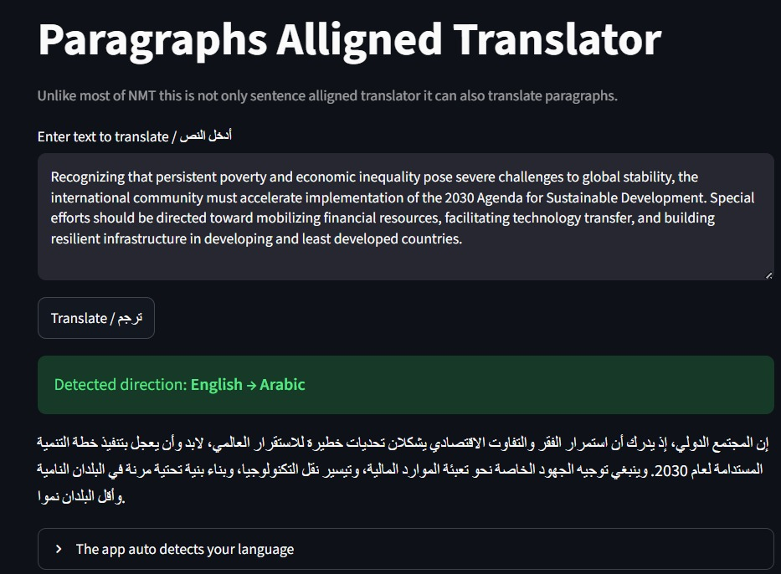
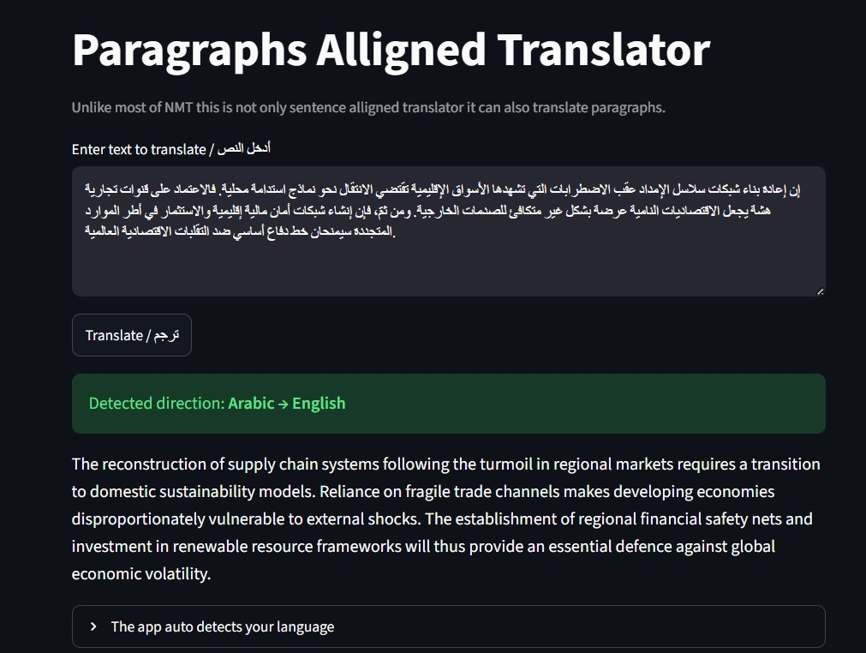
PROJECT RESULTS • TRANSFER LEARNING
FINAL EXTRA
Transfer Learning — Final Results
ENGLISH → ARABIC
ARABIC → ENGLISH
20

Slide 22

THE END
It was a long journey.
ONE of Many
Thank you
21

